Slide 1
Yatish Kaveti
ELEC7950-001: VLSI Design and Test Seminar, April 27, 2016

Slide 2
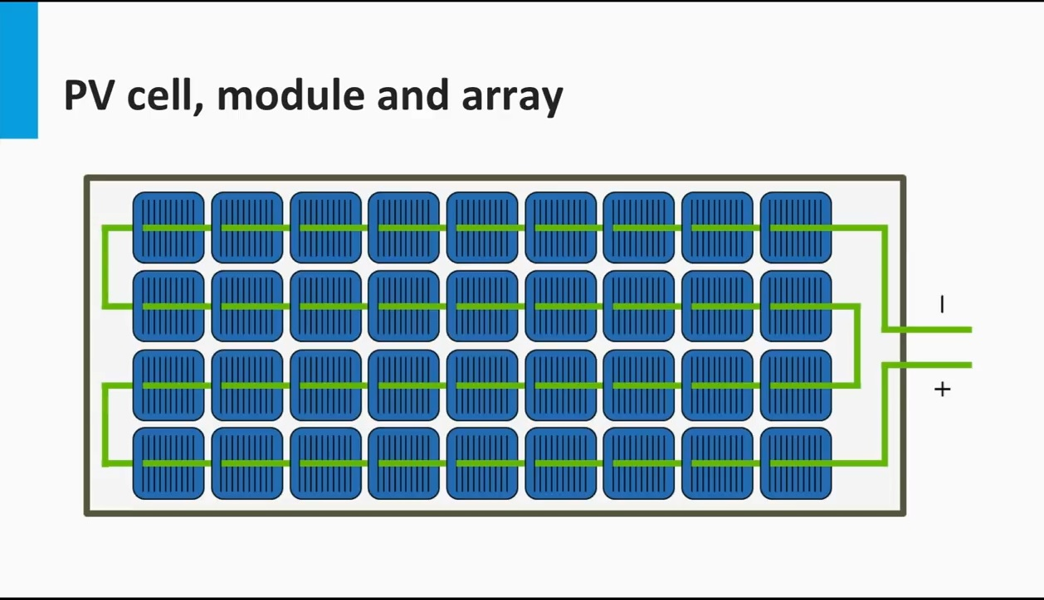

Slide 6
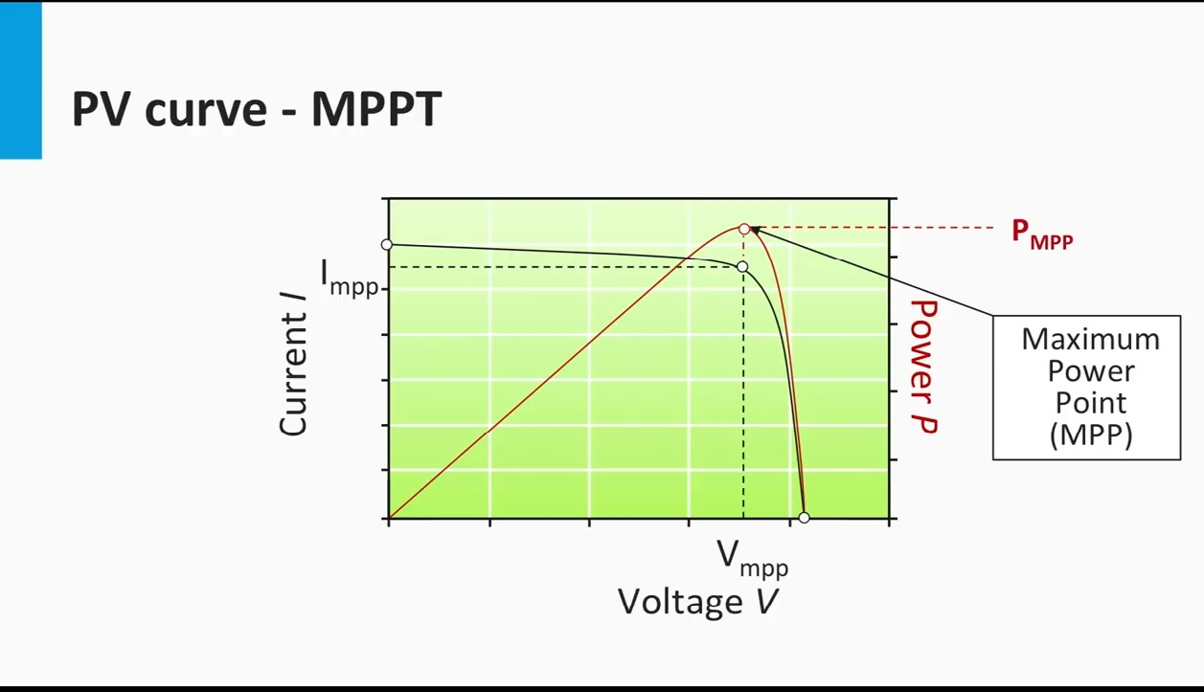

Slide 7
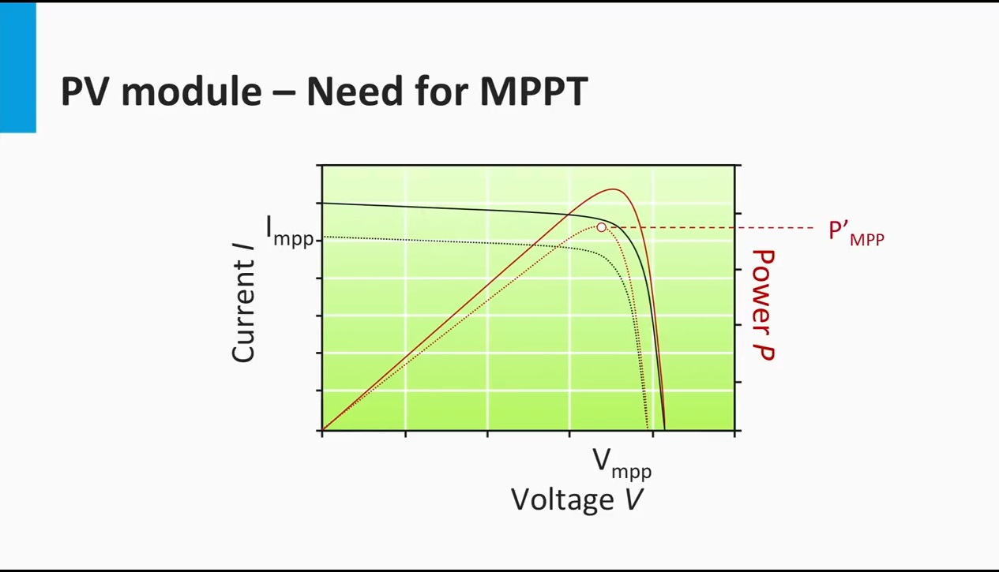

Slide 8
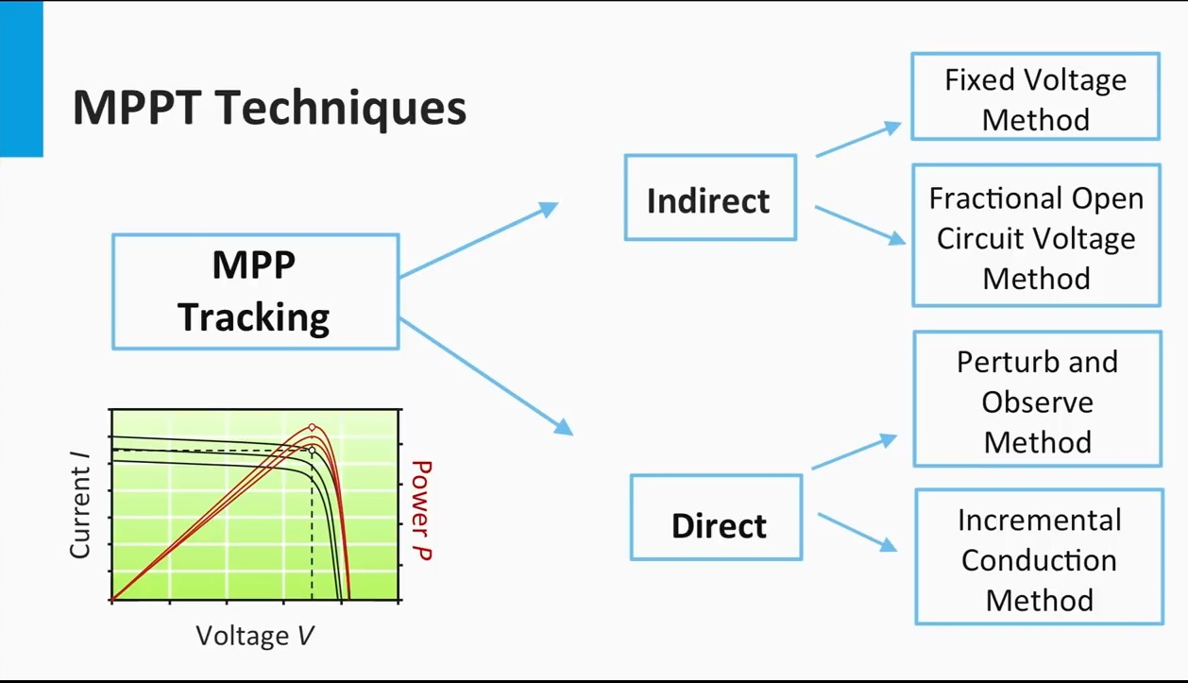

Slide 12
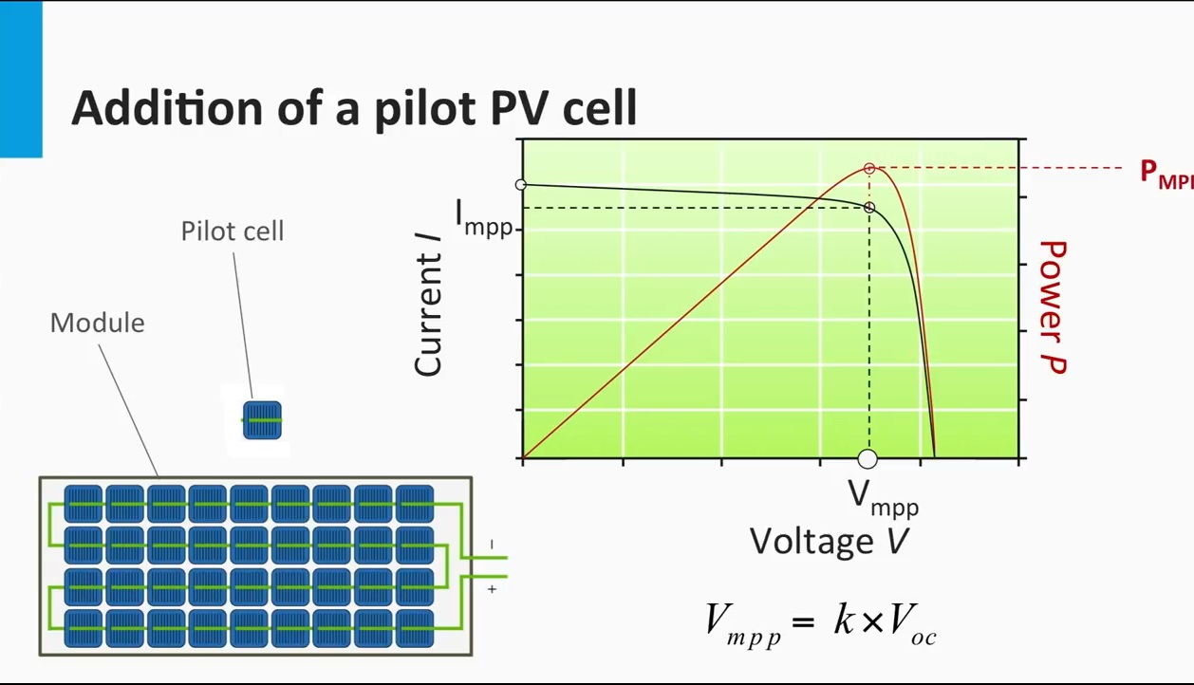

Slide 21
The End
Any Questions?

